Slide 1
Introductory Class
Pre-requisite: Data communication and computer networks.
Course Title: Automotive Cyber Security | Course Code: 20EC647
Credits (L:T:P): 3:0:0 | Total Contact Hours: 39:0:0
Type of Course: Lecture and more on case studies | Category: Professional Elective Course
CIE Marks: 50 | SEE Marks: 100

Slide 2
Unit -01
Unit 01- Introduction to security concepts 8 Hours
Introduction to Cryptography and related Infrastructure; Motivation & Security Basics: Current trends & Development, Safety and Security,
Cryptography Concepts: Encoding, Encryption, Hash, Security services, Examples of Algorithm (AES 128, RSA), Signature & Encryption, Symmetric & Asymmetric signatures.
Public Key Infrastructure: Digital Certificate, Functions of PKI, Certifying Authority, Hierarchy of Certifying Authority

Slide 3
Unit 2 and Unit 3
Unit-02 : Layered automotive security, CIA Triad 8 Hrs
Security Architecture: Software and Hardware Solutions - Introduction to Hardware Security Module (HSM), HSM and Software Crypto Libraries, Software & Hardware Encryption.
Autosar Software Architecture overview, Introduction to Autosar Communication stack, Crypto stack & Diagnostic Stack.
Unit-3: Auto-Sar Software 8 Hrs
Automotive Security Features: Challenge- Response Protocol, Secure Access, Secure Flashing. Secure On-Board Communication, Secure Boot, Secure storage, Secure Logging.
Case studies will be provided by BGSW and Presentation to be provided by students.

Slide 4
Unit-4 and Unit-5
Unit 04 – Validation and Testing 8 Hrs
Security Functional Testing- Overview; Security Features Validation: Penetration Testing-Overview, Methodology, Types of Penetration testing. Threat and Risk Analysis in Security
Case studies will be provided by BGSW and Presentation to be provided by students.
Unit 05- Project Work 8 Hrs
Project work on development of any security feature prototype. For ex: Use Oracle/SQL Server for PKI, Develop an application on Linux or In any user friendly environment and Execution
Mentoring will be provided by BGSW. The Project will be carried in the College Lab.

Slide 5
Course Outcomes
CO1: | Identify the security requirements in IT/computer & embedded systems and understand the importance of security system in automotive domain.
CO2: | Awareness about security architecture, HW & SW solutions for security challenges in automotive domain.
CO3: | Able to analyze & model the security feature use cases
CO4: | Practice analyzing the threats & risks in security feature requirement use cases.
CO5: | Identify the security requirements in IT/computer & embedded systems and understand the importance of security system in automotive domain.
Web Resources:
Sl.No. | Web link
1 | https://link.springer.com/chapter/10.1007/978-981-16-2217-5_3
2 | https://onlinecourses.nptel.ac.in/noc21_cs43/preview

Slide 6
Text Book
Sl. No. | Author/s | Title | Publisher Details
1 | William Stallings | Cryptography and Network Security -Principles and Practices | 4th Edition, Prentice Hall, 2016.
2 | Kerstin Lemke, Christof Paar, Marko Wolf; | Embedded Security in Cars | Springer Edition.
Sl. No. | Author/s | Title | Publisher Details
1 | Kleidermacher David | Embedded Systems Security | Elsevier Science & Technology
2 | Nina Godbole, Sunit Belapure | Cyber Security | Wiley

Slide 7
Evaluation Process
Test/Event | Type of Event | CIE
Test-1 | Theory Test – Unit-01 | 20 marks
Event-I | Assignment/Quiz- Unit-02 | 20 Marks
Test-2 | Theory Test- Unit-03 | 20 Marks
Event-II | Implementation/Quiz- Unit-04 | 20 Marks
Test-3 | Theory Test- Unit-5 | 20 Marks
Makeup Test | Theory Test - (Only one test is allowed to take) Unit 1-5 | 20 Marks*

Slide 8
Data and security
Data in any form like image, audio, video or text.
Basic form of data is 0’s and 1’s
Data may be personal data or public data.
Digital communication includes transmission of digital data from one system to another system within an organization or outside the organization or most of the time outside the country.
Intruder may easily filched or use your private or personal data.
Protecting digital data from unauthorized users and actions, using various measures
One of the measure by using cryptography.

Slide 9
COMPUTER SECURITY CONCEPTS
Computer Security: The protection afforded to an automated information system in order to attain the applicable objectives of preserving the integrity, availability, and confidentiality of information system resources (includes hardware, software, firmware, information/data, and telecommunications).
The NIST defines the computer security with three objectives.
These three objectives are at the heart of computer security

Slide 10

Confidentiality
Data confidentiality: Assures that private or confidential information is not made available or disclosed to unauthorized individuals.
Privacy: Assures that individuals control or influence what information related to them may be collected and stored and by whom and to whom that information may be disclosed.
OR
It is the ability of a person to determine for themselves when, how, and to what extent personal information about them is shared with or communicated to others.

Slide 11

Integrity
Data integrity: Assures that information (both stored and in transmitted packets) and programs are changed only in a specified and authorized manner.
System integrity: Assures that a system performs its intended function in an unimpaired manner or inadvertent unauthorized manipulation of the system.
Availability: Assures that systems work promptly and service is not denied to authorized users.
These three concepts form what is often referred to as the CIA triad.
Though three security objectives is well established, some in the security field feel that additional concepts are needed to present a complete security requirements.

Slide 12
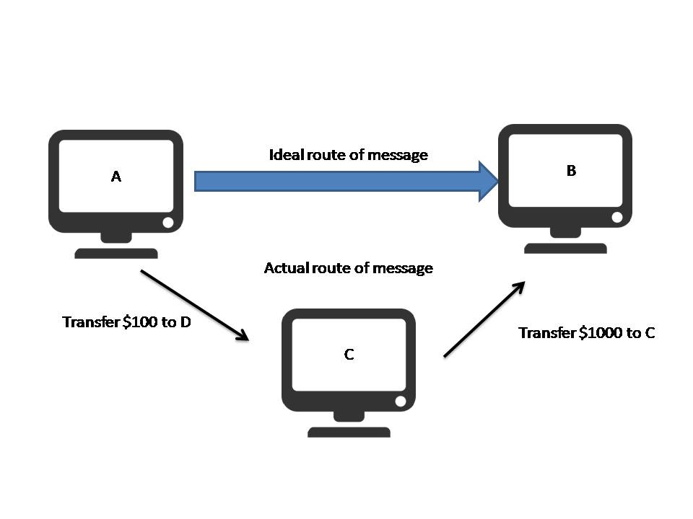
Data Integrity Violation

Slide 13
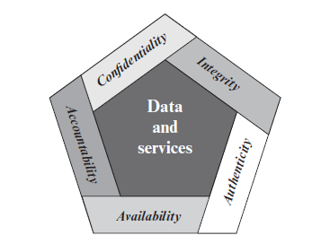
Essential Network and Computer Security Requirements
Authenticity: The property of being genuine and being able to be verified and Trusted.
Accountability: The security goal that generates the requirement for actions of an entity to be traced uniquely to that entity.
Systems must keep records of their activities to permit later forensic analysis to trace security breaches or to aid in transaction disputes.

Slide 14
The Challenges of Computer Security
Security is not as simple as it might first appear to the novice.
Exploiting an unexpected weakness in the mechanism.
Decide where to use the security mechanism.
Security mechanisms typically involve more than a particular algorithm or protocol.
Computer and network security is essentially a battle of wits between a perpetrator who tries to find holes and the designer or administrator who tries to close them.
Security requires regular, even constant monitoring.

Slide 15
THE OSI SECURITY ARCHITECTURE
The OSI security architecture focuses on security attacks, mechanisms, and services.
Security attack: Any action that compromises the security of information owned by an organization.
Security mechanism: A process that is designed to detect, prevent, or recover from a security attack.
Security service: A processing or communication service that enhances the security of the data processing systems and the information transfers of an organization.
The services are intended to counter security attacks, and they make use of one or more security mechanisms to provide the service.

Slide 16
Security Attacks
Divided into 2 types: Passive and Active attacks
Passive Attack: attempts to learn or make use of information from the system but does not affect system resources.
Passive attacks are in the nature of eavesdropping or monitoring transmissions.
The goal of the opponent is to obtain information that is being transmitted.
Passive attacks are very difficult to detect, because they do not involve any alteration of the data.
Neither the sender nor receiver is aware that a third part has read the messages or observed the traffic pattern.
However, it is feasible to prevent the success of these attacks, usually by means of encryption.

Slide 17
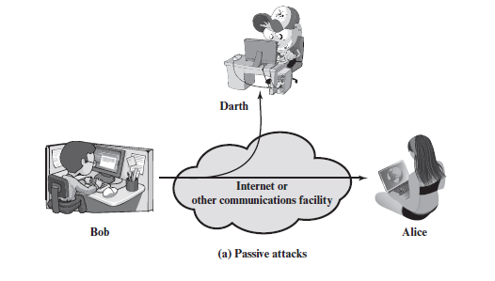
Passive attacks

Slide 18
Active attacks
Active attack: attempts to alter system resources or affect their operation
Active attacks involve some modification of the data stream or the creation of a false stream.
These attacks are subdivided into four categories: masquerade, replay, modification of messages, and denial of service.
A masquerade takes place when one entity pretends to be a different entity.
Replay involves the passive capture of a data unit and its subsequent retransmission to produce an unauthorized effect

Slide 19
Active attacks
Modification of messages simply means that some portion of a legitimate message is altered, or that messages are delayed or reordered, to produce an unauthorized effect.
The denial of service prevents or inhibits the normal use or management of communications facilities.
Active attacks present the opposite characteristics of passive attacks.

Slide 20
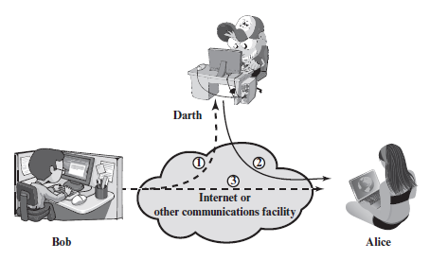
Active Attacks

Slide 21
SECURITY SERVICES
Security services: Its a processing or communication service that is provided by a system to give a specific kind of protection to system resources.
Security services implement security policies and are implemented by security mechanisms.
Authentication:
Peer Entity Authentication: Used in association with a logical connection to provide confidence in the identity of the entities connected.
Data-Origin Authentication: In a connectionless transfer, provides assurance that the source of received data is as claimed.

Slide 22
Security Services
Access Control: access control is the ability to limit and control the access to host systems and applications via communications links.
Data Confidentiality: Confidentiality is the protection of transmitted data from passive attacks.
Data Integrity: messages are received as sent with no duplication, insertion, modification, reordering, or replays.
Nonrepudiation: Nonrepudiation prevents either sender or receiver from denying a transmitted message.
Availability: System resource being accessible and usable upon demand by an authorized system entity

Slide 23
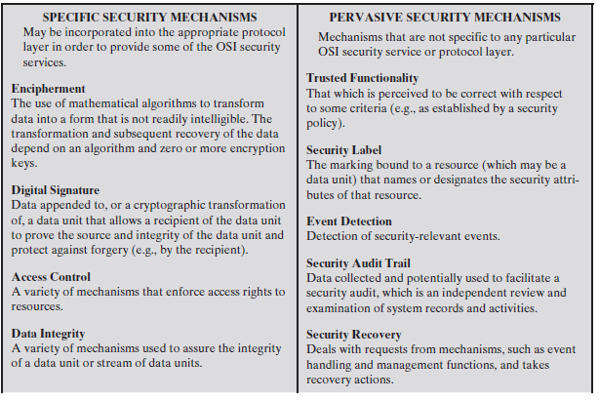
SECURITY MECHANISMS

Slide 24
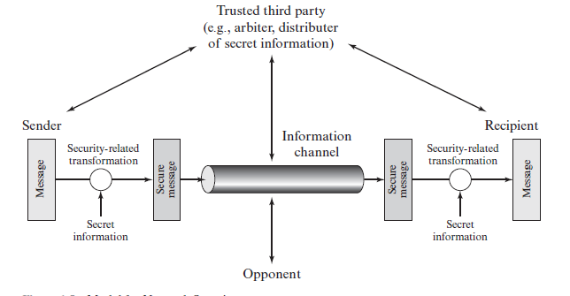
A MODEL FOR NETWORK SECURITY

Slide 25
Designing network model
This general model shows that there are four basic tasks in designing a particular security service:
Design an algorithm for performing the security-related transformation.
Generate the secret information to be used with the algorithm.
Develop methods for the distribution and sharing of the secret information.
Specify a protocol to be used by the two principals that makes use of the security algorithm and the secret information to achieve a particular security service.

Slide 26
Classical Encryption Techniques
Symmetric encryption, also referred to as conventional encryption or single-key encryption
This was the only type of encryption in use prior to the development of public key encryption in the 1970s.
Definition of some terms:
An original message is known as the plaintext and coded message is called the ciphertext.
The process of converting from plaintext to ciphertext is known as enciphering or encryption.
restoring the plaintext from the ciphertext is deciphering or decryption.

Slide 27
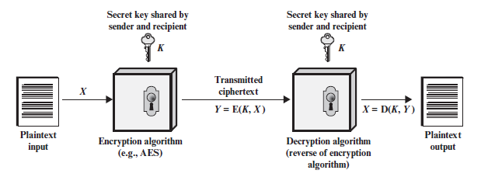
SYMMETRIC CIPHER MODEL

Slide 28
symmetric encryption scheme ingredients
Plaintext: This is the original intelligible message or data that is fed into the algorithm as input.
Encryption algorithm: The encryption algorithm performs various substitutions and transformations on the plaintext.
Secret key: The secret key is also input to the encryption algorithm. It is independent of both algorithm and plaintext.
Ciphertext: This is the scrambled message produced as output. Depends on plaintext and key.
Decryption algorithm: This is essentially the encryption algorithm run in reverse.

Slide 29
Requirements for secure use of conventional encryption
Need a strong encryption algorithm such that The opponent should be unable to decrypt ciphertext or discover the key even if he or she is in possession of a number of ciphertexts together with the plaintext that produced each ciphertext.
Sender and receiver must have obtained copies of the secret key in a secure fashion and must keep the key secure.

Slide 30
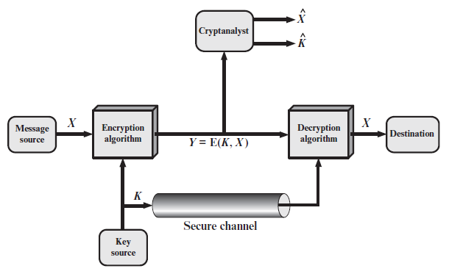
Model of Symmetric Cryptosystem

Slide 31
Cryptography
Cryptographic systems are characterized along three independent dimensions:
The type of operations used for transforming plaintext to ciphertext- Substitution or transposition.
The number of keys used- Symmetric or asymmetric.
The way in which the plaintext is processed- Block cipher or stream cipher

Slide 32
Cryptanalysis and Brute-Force Attack
The objective of attacking an encryption system is to recover the key in use rather than simply to recover the plaintext of a single ciphertext.
Crptanalysis: Cryptanalytic attacks rely on the nature of the algorithm plaintext or even some sample plaintext–ciphertext pairs. Tries to deduce plain text or key.
Brute-force attack: The attacker tries every possible key on a piece of ciphertext until an intelligible translation into plaintext is obtained.
If either type of attack succeeds in deducing the key, the effect is catastrophic: All future and past messages encrypted with that key are compromised.

Slide 33
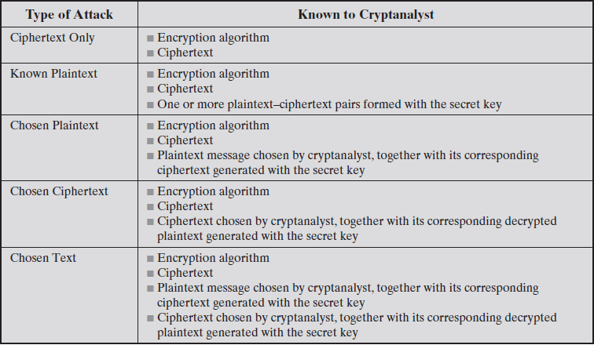
Types of Attacks on Encrypted Messages

Slide 34
SUBSTITUTION TECHNIQUES
The two basic building blocks of all encryption techniques are substitution and transposition.
A substitution technique is one in which the letters of plaintext are replaced by other letters or by numbers or symbols.
If the plaintext is viewed as a sequence of bits, then substitution involves replacing plaintext bit patterns with ciphertext bit patterns.

Slide 35

Caesar Cipher
Which uses a substitution cipher and it was developed by Julius Caesar.
The Caesar cipher involves replacing each letter of the alphabet with the letter standing three places further down the alphabet.
Substitution:

Slide 36
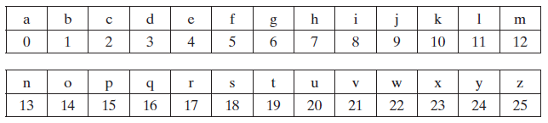
Caesar Cipher
Then the algorithm can be expressed as follows. For each plaintext letter p, substitute the ciphertext letter C:
C = E(3, p) = (p + 3) mod 26
A shift may be of any amount, so that the general Caesar algorithm is
C = E(k, p) = (p + k) mod 26
where k takes on a value in the range 1 to 25. The decryption algorithm is simply
P = D(k, C) = (C - k) mod 26

Slide 37
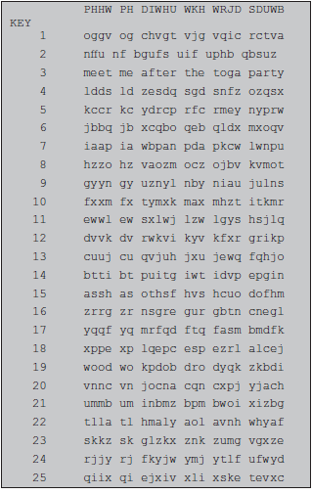
Cont..
If it is known that a given ciphertext is a Caesar cipher, then a brute-force cryptanalysis is easily performed: simply try all the 25 possible keys.

Slide 38
Monoalphabetic Ciphers
With only 25 possible keys, the Caesar cipher is far from secure.
A dramatic increase in the key space can be achieved by allowing an arbitrary substitution.
Its works on the frequency of letters used in the ciphertext compared with plaintext.
Monoalphabetic substitution cipher refers, a single cipher alphabet mapping from plain alphabet to cipher alphabet.
If the cryptanalyst knows the nature of the plaintext (e.g., noncompressed English text), then the analyst can exploit the regularities of the language.

Slide 39

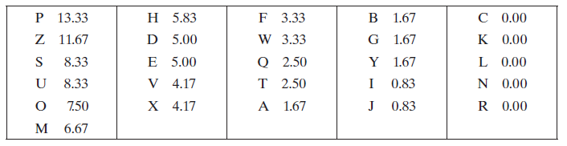
Monoalphabetic Ciphers
As a first step, the relative frequency of the letters can be determined and compared to a standard frequency distribution for English.
Comparing this breakdown with English letter distribution.

Slide 40
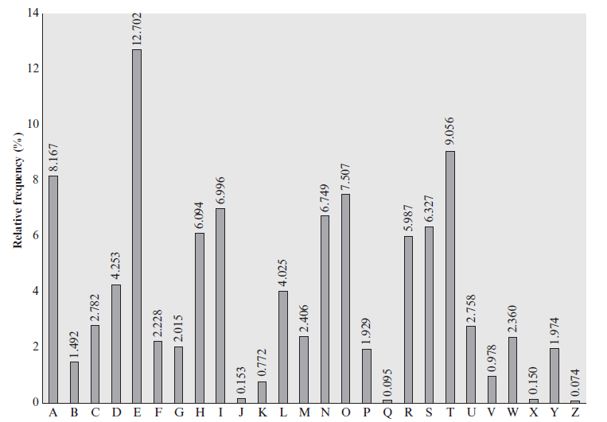
Relative Frequency of Letters in English Text

Slide 41
Monoalphabetic Cipher
It seems likely that cipher letters P and Z are the equivalents of plain letters e and t, but it is not certain which is which.
The letters S, U, O, M, and H are all of relatively high frequency and probably correspond to plain letters from the set {a, h, i, n, o, r, s}.
The letters with the lowest frequencies (A, B, G, Y, I, J) are likely included in the set {b, j, k, q, v, x, z}.
At this point, Attacker makes tentative assignments and start to fill in the plaintext to see if it looks like a reasonable “skeleton” of a message.

Slide 42
Monoalphabetic cipher
A powerful tool is to look at the frequency of two-letter combinations, known as digrams.
The most common such digram is th. In ciphertext, the most common digram is ZW, which appears three times.
So we make the correspondence of Z with t and W with h.
With the hypothesis, we can equate P with e. Now notice that the sequence ZWP appears in the ciphertext, hence translate that sequence as “the.”
the sequence ZWSZ in the first line. it is of the form th_t. If so, S equates with a.

Slide 43
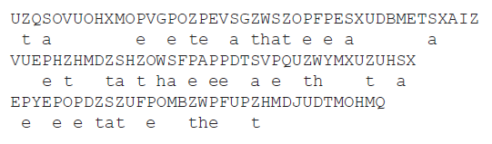

Cont..
Continued analysis of frequencies plus trial and error should easily yield a solution from this point.
The complete plaintext, with spaces added between words, follows:

Slide 44
Disadvantage
Monoalphabetic ciphers are easy to break because they reflect the frequency data of the original alphabet.
A countermeasure is to provide multiple substitutes, known as homophones, for a single letter.
For example, the letter e could be assigned a number of different cipher symbols, such as 16, 74, 35, and 21, with each homophone assigned to a letter in rotation or randomly.

Slide 45
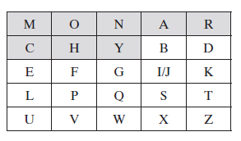
Playfair Cipher
Playfair is the best-known multiple-letter encryption cipher.
Palyfair treats digrams in the plaintext as single units and translates these units into ciphertext digrams.
The Playfair algorithm is based on the use of a 5 * 5 matrix of letters constructed using a keyword.

Slide 46
Cont..
The matrix is constructed by filling in the letters of the keyword from left to right and from top to bottom.
Later filling in the remainder of the matrix with the remaining letters in alphabetic order.
The letters I and J count as one letter.
Plaintext is encrypted two letters at a time, according to the following rules:

Slide 47
Playfair Encryption Rules
Repeating plaintext letters that are in the same pair are separated with a filler letter, such as x, so that balloon would be treated as ba lx lo on.
Two plaintext letters that fall in the same row of the matrix are each replaced by the letter to the right, with the first element of the row circularly following the last. For example, ar is encrypted as RM.
Two plaintext letters that fall in the same column are each replaced by the letter beneath, with the top element of the column circularly following the last. For example, mu is encrypted as CM.
Otherwise, each plaintext letter in a pair is replaced by the letter that lies in its own row and the column occupied by the other plaintext letter. Thus, hs becomes BP and ea becomes IM (or JM, as the encipherer wishes).

Slide 48
Advantage
The Playfair cipher is a great advance over simple monoalphabetic ciphers.
In monoaplhabetic cipher, there are only 26 letters but in playfair there are 26 * 26 = 676 digrams.
So that identification of individual digrams is difficult.
It was used by British Army in World War I and U.S. Army and other Allied forces during World War II.
The Playfair cipher is relatively easy to break, because it still leaves much of the structure of the plaintext language intact.

Slide 49
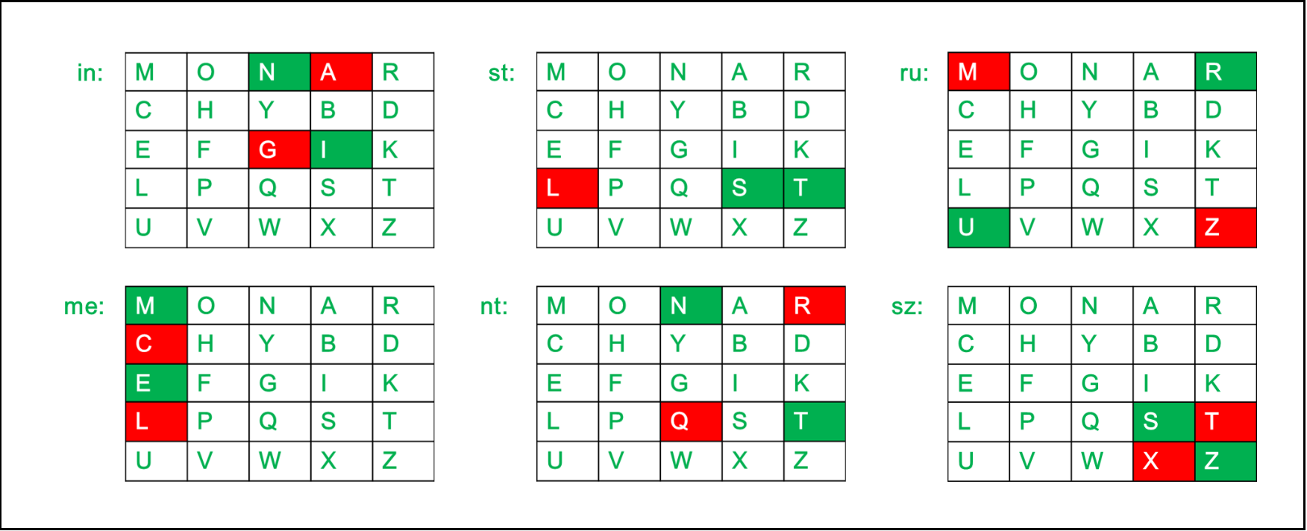
Example
Encrypt the Plaintext: Instruments using playfair cipher. Use Monarchy as a keyword.

Slide 50
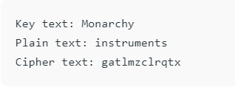
Solution

Slide 51
Polyalphabetic Ciphers
Another way to improve on the simple monoalphabetic technique is to use different monoalphabetic substitutions.
The general name for this approach is polyalphabetic substitution cipher.
All these techniques have the following features in common:
A set of related monoalphabetic substitution rules is used.
A key determines which particular rule is chosen for a given transformation.

Slide 52
VIGENÈRE CIPHER
The best known, and one of the simplest, polyalphabetic ciphers is the Vigenère cipher.
We can express the Vigenère cipher in the following manner.
Assume a sequence of plaintext letters P = p0, p1, p2,…, pn-1.
key consisting of the sequence of letters K = k0, k1, k2,..,km-1, where typically m<n.
The sequence of ciphertext letters C = C0, C1, C2, .., Cn-1 is calculated as follows:
C = C0, C1, C2, c, Cn-1 = E(K, P) = E[(k0, k1, k2, c, km-1), (p0, p1, p2, c, pn-1)]
= (p0 + k0) mod 26, (p1 + k1) mod 26, c,(pm-1 + km-1) mod 26,
(pm + k0) mod 26, (pm+1 + k1) mod 26, c, (p2m-1 + km-1) mod 26..

Slide 53
VIGENÈRE CIPHER
Thus, the first letter of the key is added to the first letter of the plaintext, mod 26, the second letters are added, and so on through the first m letters of the plaintext.
For the next m letters of the plaintext, the key letters are repeated.
This process continues until all of the plaintext sequence is encrypted.
A general equation of the encryption process is:
Ci = (pi + ki mod m) mod 26
Similarly, decryption is a generalization of Equation:
pi = (Ci - ki mod m) mod 26
To encrypt a message, a key is needed that is as long as the message.
Usually, the key is a repeating keyword.

Slide 54

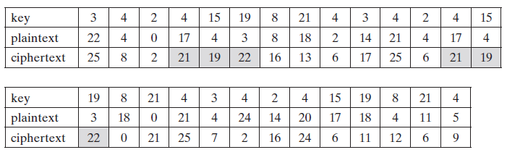
Example
For example, if the keyword is deceptive, the message “we are discovered save yourself” is encrypted as:

Slide 55
Advantage
The strength of this cipher is that there are multiple ciphertext letters for each plaintext letter, one for each unique letter of the keyword.
Thus, the letter frequency information is obscured.
on the other hand, a Vigenère cipher is suspected.
The important insight that leads to a solution is the following:
If two identical sequences of plaintext letters occur at a distance that is an integer multiple of the keyword length, they will generate identical ciphertext sequences.
In the foregoing example, two instances of the sequence “red” are separated by nine character positions.
Thus, in both cases, the ciphertext sequence is VTW.
An analyst looking at only the ciphertext would detect the repeated sequences VTW.

Slide 56

More advanced vigenerr cipher
The periodic nature of the keyword can be eliminated by using a nonrepeating keyword that is as long as the message itself.
Vigenère proposed what is referred to as an autokey system, in which a keyword is concatenated with the plaintext itself to provide a running key.
For example:

Slide 57
VERNAM CIPHER
The ultimate defense against such a cryptanalysis is to choose a keyword that is as long as the plaintext and has no statistical relationship to it.
The cipher was introduced by an AT&T engineer named Gilbert Vernam in 1918.
The system works on binary data (bits) rather than letters.
The system can be expressed succinctly as follows:
ci = pi⊕ki
where
pi = ith binary digit of plaintext
ki = ith binary digit of key
ci = ith binary digit of ciphertext
⊕ = exclusive@or (XOR) operation

Slide 58
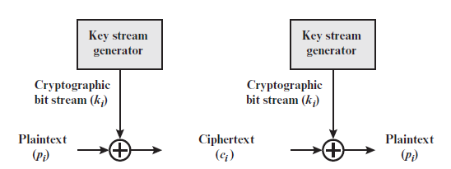
Vernam Cipher Model

Slide 59
Vernam Cipher
Thus, the ciphertext is generated by performing the bitwise XOR of the plaintext and the key.
Because of the properties of the XOR, decryption simply involves the same bitwise operation:
pi = ci⊕ki
The essence of this technique is the means of construction of the key.
Vernam proposed the use of a running loop of tape that eventually repeated the key, so that in fact the system worked with a very long but repeating keyword.
It can be broken with sufficient ciphertext, the use of known or probable plaintext sequences, or both.

Slide 60
One-Time Pad
It’s a improvised version of vernam cipher.
Mauborgne suggested using a random key that is as long as the message, so that the key need not be repeated.
In addition, the key is to be used to encrypt and decrypt a single message, and then is discarded.
Each new message requires a new key of the same length as the new message.
Such a scheme, known as a one-time pad, is unbreakable.
It produces random output that bears no statistical relationship to the plaintext.

Slide 61
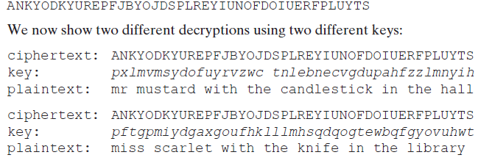
Example

Slide 62
Advantages and disadvantage
For given any key, Attacker would end up with many legible plaintexts, with no way of knowing which was the intended plaintext. Therefore, the code is unbreakable.
The security of the one-time pad is entirely due to the randomness of the key.
Thus, there are no patterns or regularities that a cryptanalyst can use to attack the ciphertext.
The one-time pad offers complete security but, in practice, has two fundamental difficulties:
There is the practical problem of making large quantities of random keys. heavily used system might require millions of random characters on a regular basis.
Even more daunting is the problem of key distribution and protection. For every message to be sent, a key of equal length is needed by both sender and receiver.

Slide 63

TRANSPOSITION TECHNIQUES
All the previous ciphers are based on substitution method.
A very different kind of mapping is achieved by performing some sort of permutation on the plaintext letters.
This technique is referred to as a transposition cipher.
The simplest such cipher is the rail fence technique, in which the plaintext is written down as a sequence of diagonals and then read off as a sequence of rows.
For example, to encipher the message “meet me after the toga party” with a rail fence of depth 2, we write the following:
The encrypted message is: MEMATRHTGPRYETEFETEOAAT

Slide 64
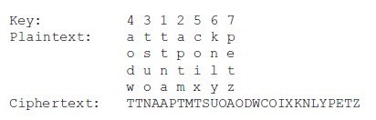
Transposition Techniques
A more complex scheme is to write the message in a rectangle, row by row, and read the message off, column by column, but permute the order of the columns.
The order of the columns then becomes the key to the algorithm. For example,

Slide 65
Cont..
Thus, in this example, the key is 4312567.
To encrypt, start with the column that is labeled 1, in this case column 3.
Write down all the letters in that column. Proceed to column 4, which is labeled 2, then column 2, then column 1, then columns 5, 6, and 7.
pure transposition cipher is easily recognized because it has the same letter frequencies as the original plaintext.
The transposition cipher can be made significantly more secure by performing more than one stage of transposition.
The result is a more complex permutation that is not easily reconstructed.

Slide 66
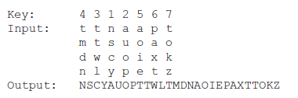

Cont..
if the foregoing message is reencrypted using the same algorithm, It can be represented as follow:
To visualize the result of this double transposition, designate the letters in the original plaintext message by the numbers designating their position.

Slide 67


Cont..
After the first transposition, we have
which has a somewhat regular structure. But after the second transposition, we have

Slide 68
Hill Cipher
Another interesting multiletter cipher is the Hill cipher, developed by the mathematician Lester Hill in 1929.
Hill cipher requires some knowledge about the linear algebra.
Hill cipher is concerned with matrix arithmetic modulo 26.
We define the inverse M-1 of a square matrix M by the equation M(M-1) = M-1M = I, where I is the identity matrix.
I is a square matrix that is all zeros except for ones along the main diagonal from upper left to lower right.
The inverse of a matrix does not always exist, but when it does, it satisfies the preceding equation.

Slide 69
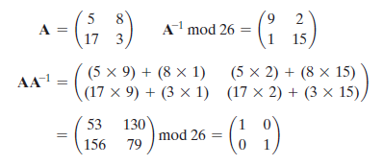
Identity matrix

Slide 70

Inverse of a matrix
To explain how the inverse of a matrix is computed, we begin with the concept of determinant.
For any square matrix (m * m), the determinant equals the sum of all the products that can be formed by taking exactly one element from each row and exactly one element from each column.
For example, For any given a 2 * 2 matrix, the determinant is k11k22 - k12k21.
For a 3 * 3 matrix, the value of the determinant is k11k22k33 + k21k32k13 + k31k12k23 - k31k22k13 - k21k12k33 - k11k32k23.
matrix A has a nonzero determinant, then the inverse of the matrix is computed as
where (Dji) is the subdeterminant formed by deleting the jth row and the ith column of A

Slide 71

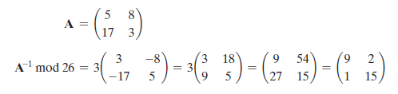
Determinant of matrix A
det(A) is the determinant of A, and (det A)-1 is the multiplicative inverse of (det A) mod 26.
We can show that 9-1 mod 26 = 3, because 9 * 3 = 27 mod 26 = 1.

Slide 72
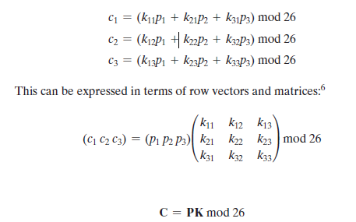
THE HILL ALGORITHM
The encryption algorithm takes m successive plaintext letters and substitutes for them m ciphertext letters.
The substitution is determined in which each character is assigned a numerical value (a = 0, b = 1, c, z = 25).
For m = 3, the system can be described as:

Slide 73

Hill Cipher- Encryption
Where C and P are row vectors of length 3 representing the plaintext and ciphertext, and K is a 3 * 3 matrix representing the encryption key.
Consider the plaintext “paymoremoney” and use the encryption key:
The first three letters of the plaintext are represented by the vector (15 0 24).
Then (15 0 24)K = (303 303 531) mod 26 = (17 17 11) = RRL.
Continuing in this fashion, the ciphertext for the entire plaintext is RRLMWBKASPDH.

Slide 74

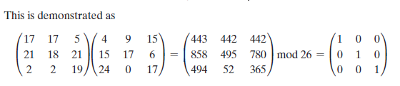
Hill Cipher-Decryption
Decryption requires using the inverse of the matrix K.
We can compute det (K) = 23, and therefore, (det K)-1 mod 26 = 17.
We can then compute the inverse as:

Slide 75

Hill Cipher -Decryption
It is easily seen that if the matrix K-1 is applied to the ciphertext, then the plaintext is recovered.
In general terms, the Hill system can be expressed as:

Slide 76
Unit-01 Part B
Block Ciphers and the Data Encryption Standard

Slide 77
Stream Ciphers and Block Ciphers
A stream cipher is one that encrypts a digital data stream one bit or one byte at a time.
Examples of classical stream ciphers are the autokeyed Vigenère cipher and the Vernam cipher.
If the cryptographic keystream is random, then this cipher is unbreakable by any means other than acquiring the keystream.
However, the keystream must be provided to both users in advance via some independent and secure channel.
This introduces insurmountable logistical problems if the intended data traffic is very large.
Accordingly, for practical reasons, the bit-stream generator must be implemented as an algorithmic procedure.
Keys generation is easy, so that the cryptographic bit stream can be produced by both users.

Slide 78
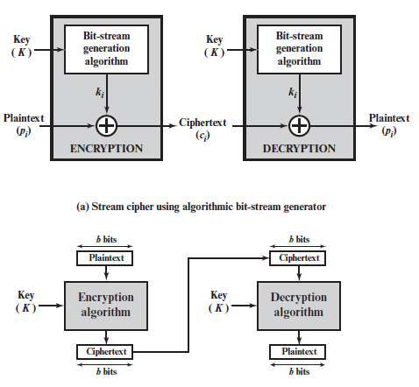
Stream cipher VS block ciphers

Slide 79
Cont..
A block cipher is one in which a block of plaintext is treated as a whole and used to produce a ciphertext block of equal length.
Typically, a block size of 64 or 128 bits is used.
As with a stream cipher, the two users share a symmetric encryption key.
block cipher can be used to achieve the same effect as a stream cipher.
The vast majority of network-based symmetric cryptographic applications make use of block ciphers.
A block cipher operates on a plaintext block of n bits to produce a ciphertext block of n bits.

Slide 80
The Feistel Cipher
Feistel proposed the use of a cipher that alternates substitutions and permutations
Substitution: Each plaintext element or group of elements is uniquely replaced by a corresponding ciphertext element or group of elements.
Permutation: A sequence of plaintext elements is replaced by a permutation of that sequence.
That is, no elements are added or deleted or replaced in the sequence, rather the order in which the elements appear in the sequence is changed.
In particular, the Feistel structure is used for Triple Data Encryption Algorithm (TDEA), which is one of the two encryption algorithms (along with AES), approved for general use by the National Institute of Standards and Technology (NIST).

Slide 81
DIFFUSION AND CONFUSION
The terms diffusion and confusion were introduced by
Claude Shannon to capture the two basic building blocks for any cryptographic system.
Assume the attacker has some knowledge of the statistical characteristics of the plaintext.
For example, in a human-readable message in some language, the frequency distribution of the various letters may be known. Or there may be words or phrases likely to appear in the message.
If these statistics are in any way reflected in the ciphertext, the cryptanalyst may be able to deduce the encryption key, part of the key, or at least a set of keys likely to contain the exact key.
Shannon suggests two methods for frustrating statistical cryptanalysis: diffusion and confusion.

Slide 82
Cont..
In diffusion, the statistical structure of the plaintext is dissipated into long-range statistics of the ciphertext.
This is achieved by having each plaintext digit affect the value of many ciphertext digits.
The mechanism of diffusion seeks to make the statistical relationship between the plaintext and ciphertext as complex as possible in order to thwart attempts to deduce the key.
Confusion seeks to make the relationship between the statistics of the ciphertext and the value of the encryption key as complex as possible.
Thus, even if the attacker can get some handle on the statistics of the ciphertext, the way in which the key was used to produce that ciphertext is so complex as to make it difficult to deduce the key.
This is achieved by the use of a complex substitution algorithm.

Slide 83
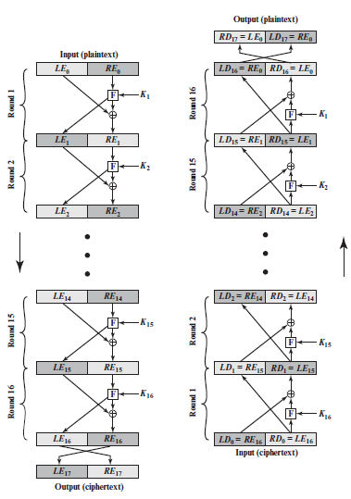
FEISTEL CIPHER STRUCTURE

Slide 84
FEISTEL CIPHER STRUCTURE
The left-hand side depicts the encryption structure proposed by Feistel.
The inputs to the encryption algorithm are a plaintext block of length 2w bits and a key K.
The plaintext block is divided into two halves, LE0 and RE0.
The two halves of the data pass through n rounds of processing and then combine to produce the ciphertext block.
Each round i has as inputs LEi-1 and REi-1 derived from the previous round, as well as a subkey Ki derived from the overall K.
In general, the subkeys Ki are different from K and from each other.
In the given example 16 rounds are used, although any number of rounds could be implemented.

Slide 85
Cont..
All rounds have the same structure. A substitution is performed on the left half of the data.
This is done by applying a round function F to the right half of the data and then taking the exclusive-OR of the output of that function and the left half of the data.
The round function has the same general structure for each round but is parameterized by the round subkey Ki.
In general, F is a function of right-half block of w bits and a subkey of y bits, which produces an output value of length w bits: F(REi, Ki+1).
Following this substitution, a permutation is performed that consists of the interchange of the two halves of the data
This structure is a particular form of the substitution-permutation network (SPN) proposed by Shannon.

Slide 86
Parameters and design features of Feistel Structure
Block size: Larger block sizes mean greater security. but reduced encryption/decryption speed for a given algorithm. raditionally, a block size of 64 bits has been considered a reasonable tradeoff and was nearly universal in block cipher design.
Key size: Larger key size means greater security but may decrease encryption/ decryption speed. The greater security is achieved by greater resistance to brute-force attacks and greater confusion.
Key sizes of 64 bits or less are now widely considered to be inadequate, and 128 bits has become a common size.
Number of rounds: The essence of the Feistel cipher is that a single round offers inadequate security but that multiple rounds offer increasing security. A typical size is 16 rounds.

Slide 87
Cont..
Subkey generation algorithm: Greater complexity in this algorithm should lead to greater difficulty of cryptanalysis.
Round function F: Again, greater complexity generally means greater resistance to cryptanalysis.

Slide 88
FEISTEL DECRYPTION ALGORITHM
The process of decryption with a Feistel cipher is essentially the same as the encryption process.
Use the ciphertext as input to the algorithm, but use the subkeys Ki in reverse order.
Use Kn in the first round, Kn-1 in the second round, and so on, until K1 is used in the last round.
The diagram indicates that, at every round, the intermediate value of the decryption process is equal to the corresponding value of the encryption process with the two halves of the value swapped.
Lets assume the output of the ith encryption round be LEi ||REi (LEi concatenated with REi).
Then the corresponding output of the (16 - i)th decryption round is REi ||LEi or, equivalently,LD16-i ||RD16-i.

Slide 89
Feistel Decryption Process
After the last iteration of the encryption process, the two halves of the output are swapped, so that the ciphertext is RE16|LE16.
The output of that round is the ciphertext. Now take that ciphertext and use it as input to the same algorithm.
The input to the first round is RE16||LE16, which is equal to the 32-bit swap of the output of the sixteenth round of the encryption process.
The output of the first round of the decryption process is equal to a 32-bit swap of the input to the sixteenth round of the encryption process.
First, consider the encryption process. We see that
LE16 = RE15
RE16 = LE15 ⊕F(RE15, K16)

Slide 90
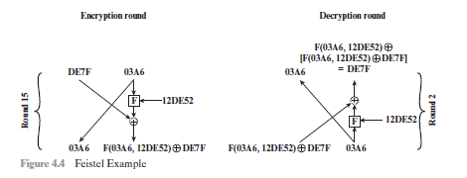
Cont..
On the decryption side,
LD1 = RD0 = LE16 = RE15
RD1 = LD0 ⊕F(RD0, K16)
= RE16 ⊕F(RE15, K16)
= [LE15 ⊕F(RE15, K16)]⊕F(RE15, K16)
Thus, we have LD1 = RE15 and RD1 = LE15. Therefore, the output of the first round of the decryption process is RE15 ||LE15. which is the 32-bit swap of the input to the sixteenth round of the encryption.

Slide 91
THE DATA ENCRYPTION STANDARD
The Data Encryption Standard (DES) was the most widely used encryption scheme.
The algorithm itself is referred to as the Data Encryption Algorithm (DEA).
For DEA, data are encrypted in 64-bit blocks using a 56-bit key.
The algorithm transforms 64-bit input in a series of steps into a 64-bit output. The same steps, with the same key, are used to reverse the encryption.
Over the years, DES became the dominant symmetric encryption algorithm, especially in financial applications.

Slide 92
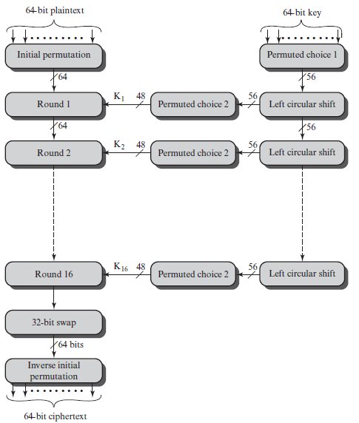
DES Encryption

Slide 93
DES Encryption Process
As with any encryption scheme, there are two inputs to the encryption function: the plaintext to be encrypted and the key.
In this case, the plaintext must be 64 bits in length and the key is 56 bits in length.
The processing of the plaintext proceeds in three phases.
First, the 64-bit plaintext passes through an initial permutation (IP) that rearranges the bits to produce the permuted input.
This is followed by a phase consisting of sixteen rounds of the same function, which involves both permutation and substitution functions.
The output of the last (sixteenth) round consists of 64 bits that are a function of the input plaintext and the key.
The left and right halves of the output are swapped to produce the preoutput.

Slide 94
Cont..
Finally, the preoutput is passed through a permutation [IP-1] that is the inverse of the initial permutation function, to produce the 64-bit ciphertext.
With the exception of the initial and final permutations, DES has the exact structure of a Feistel cipher.
The right-hand portion shows the way in which the 56-bit key is used.
Initially, the key is passed through a permutation function.
Then, for each of the sixteen rounds, a subkey (Ki) is produced by the combination of a left circular shift and a permutation.
The permutation function is the same for each round, but a different subkey is produced because of the repeated shifts of the key bits.
As with any Feistel cipher, decryption uses the same algorithm as encryption, except that the application of the subkeys is reversed. The initial and final permutation also reversed.

Slide 95

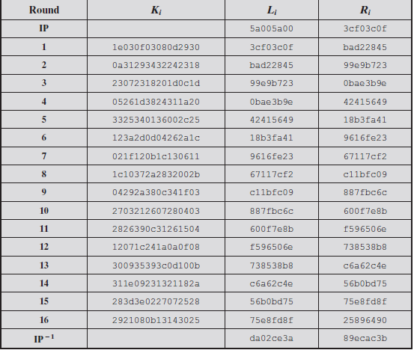
A DES EXAMPLE

Slide 96
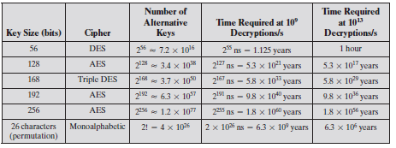
THE STRENGTH OF DES
The Use of 56-Bit Keys.
The Nature of the DES Algorithm.
Timing Attacks.
Average Time Required for Exhaustive Key Search

